Slide 1
Discover how to improve productivity
by going DevOps and SAFe

Slide 2
Presented by:
John Kosco is an executive with over 26 years of experience within Information Technology, with both Systems Delivery and IT Operations experience in the Financial industry.
He fosters a constructive change culture, guides organizations through transformational programs and provides coaching in the adoption of the latest Software Delivery methods.
He is a recognized in the industry for advising on Continuous Improvement, SAFe Practices, Agile Scrum, DevOps, Continuous Delivery Automation, Service Virtualization and Lean IT to meet the needs of the firm’s clients.
ACCELERATE DELIVERY
New applications
Changes to existing apps
Bug fixes
INCREASE RELIABILITY
Software is the customer experience
Quality and Performance are critical
MANAGE COMPLEXITY
Composite services and heterogeneous systems
Reduced budgets
Distributed development teams and IT partners

Slide 3
Today’s Case Study focuses on
A real world case study of a Fortune 100 company within the Financial Industry
In business for over 100 years
Increased Product Delivery Velocity by 16X

Slide 4
4 Keys to Improve Delivery:
Leadership: Executive Sponsorship with Vision Alignment
Proven Framework: Leveraged SAFe; a Three Tiered System
People: Clear Definition of Roles and Change Agents
Tools: Increased Automation

Slide 5

Started with a Value Stream
A Senior Executive identified Strategic Themes.
Theses themes were itemized Business Objectives.
They provided business context for the decision making within the portfolio.
Senior Leadership had the ability to continuously improve the entire Delivery System.
Senior Executive

Slide 6

Value Stream became Business Epics at a Portfolio Level (1st Level)
Members of the Portfolio Management Team established Business Epics that went through a WIP/Kanban System to review, analyze, estimate, rank and approve for implementation.
Leveraged WIP Limits ensured that teams responsible for analysis were able to do so and did not overload the system.
Lightweight business cases were created out of this process for each Epic that highlighted the business sponsors, impacts to customers, dependencies between teams and estimated development effort.
These business cases were than used by the appropriate parties to make a go/no go decision on each the Epics.
Portfolio
Management
Team

Slide 7

Approved Business Cases become Features at the Program Level
(2nd Level)
Members of the Product Management team defined and ranked the Features in a Program Backlog.
The Features enable the Product Manager to describe the products in terms of it’s offerings and benefits.
The Program Backlog ensured the Release Train’s value delivery via a series of Releases.
Funding was requested and approved for the entire Release Train.
Product
Management

Slide 8


A Release Train was a group of people aligned to a common mission
Agile Release Train
The Release Train was a team of agile teams, typically 50–125 individuals, that served as a delivery mechanism. Release Trains were organized around the Value Stream.
The Release trains aligned the teams to a common mission, provided 8-12 weeks of planning, development, retrospectives and continuous product delivery flow.
The Release Train Engineer, was the Chief Scrum Master for the entire Train.
He facilitated program level processes, ensured program delivery, a point of escalation for Scrum Masters and helped facilitated continuous improvement.
Agile Release Train Engineer

Slide 9
Ranked Features become Stories at the Team Level (3rd Level)
Product Owners defined and ranked the Stories within the Team’s Backlog.
The Product Owner was the only person empowered to accept new Stories and indicated when Stories were Done.
This was a critical role that was responsible for overall Product Management within the team.
Product
Owners

Slide 10


Scrum Masters lead Developer/Tester teams to finish Tasks to complete Stories at the Team Level
Scrum Master primary responsibility was to help the self-organizing, self-managing team achieve their goals.
They did this by teaching Scrum, implementing Scrum practices and identifying/eliminating impediments.
Scrum
Master
Developers and Testers made up the majority of an Agile team. Developers conducted analysis, designed, prototyped and wrote the code for the stories.
Testers worked in parallel with the developers to write acceptance test cases and leveraged Testing Automation as appropriate.
Developer/Tester Team

Slide 11
Increased Automation via Continuous Delivery
Continuous Delivery (CD) is a design practice used in software development to automate and improve the process of software delivery. Techniques such as automated testing, continuous integration and continuous deployment allow software to be developed to a high standard and easily packaged and deployed to test environments, resulting in the ability to rapidly, reliably and repeatedly push out enhancements and bug fixes to customers at low risk and with minimal manual overhead.
-- Wikipedia
ACCELERATE DELIVERY
New applications
Changes to existing apps
Bug fixes
INCREASE RELIABILITY
Software is the customer experience
Quality and Performance are critical
MANAGE COMPLEXITY
Composite services and heterogeneous systems
Reduced budgets
Distributed development teams and IT partners

Slide 12



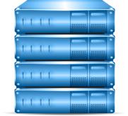




Automation addressed the following challenges
DELAYED INTEGRATION TESTING (too many bugs escape downstream)
LACK OF AUTOMATED TESTING (small changes could have major unintended consequences)
LACK OF VISIBILITY INTO PROD. APPS (no visibility into the customer experience)
Code
Commit
Build
Developer 1
Source Control
Code
Commit
Deployable Asset
deploy
Build
deploy
deploy
deploy
Developer 2
UAT/Staging
Environment
Operations
Source Control
Integration Lab
Production
deploy
Performance Lab
Code
Commit
Build
LACK OF RELEASE AND ENVIRONMENT AUTOMATION (manual processes lead to poor release quality)
Developer n
Source Control
Deployable Asset

Slide 13
Transforming to DevOps…
CONTINUOUS VALIDATION
Code
Commit
Build
Developer 1
Source Control
deploy
Code
Commit
Deployable/Virtualized Assets
Build
Developer 2
UAT/Staging
Environment
Operations
Source Control
Integration Lab
Production
deploy
Performance Lab
Code
Commit
Build
Developer n
Source Control
Deployable/
Virtualized Asset
TEST DATA
MANAGEMENT
TRUE AGILE
DEVELOPMENT
CONTINUOUS DELIVERY

Slide 14
Transforming with Release Automation…
Clients have orchestrated the entire application release process and automated the deployment of applications from
development through production.
Sped up application release cycles and improved business and operational agility
Reduced errors and achieve higher quality releases by simplifying and standardizing application release processes
Enabled more frequent releases and reduce risk of failure
Reduced costs of application deployments and promote collaboration and alignment between Development and Operations
Improved visibility across the entire deployment tool chain

Slide 15
Transforming with Service Virtualization…
Clients have “shifted left” which means in its simplest terms
to move your software testing efforts to the
left side of a horizontal timeline.
Shifted Left – Defects found/addressed earlier in the development lifecycle
Integration Testing with virtualized future 3rd party vendor releases
Increased Infrastructure availability
Earlier Performance Testing within lifecycle
Improved Data & Test Scenario management
Increased Predictability of Scheduled Deliverables

Slide 16
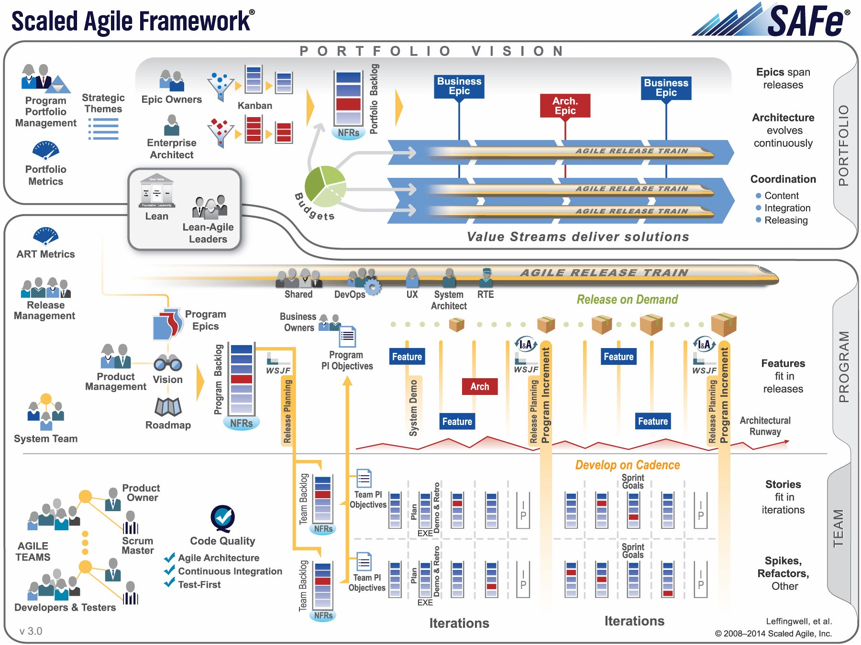
Work with a Proven Framework…SAFe
SAFe is a proven framework for applying Lean and Agile practices at enterprise scale

Slide 17


Slide 18

Notes:
18

